Slide 1

Domain: Developing a ubiquitous smart homes with health care for the elderly
Luyi Dai (Louise)

Slide 2
Quick recap:
Population growth, especially the increase in ageing, has brought a great burden to medical care, and the elderly may not receive adequate medical assistance.
Aim to increase the elderly’s independence, life quality, medical care quality, and self-efficiency.
Target audience: the elderly and potential elderly over 50 years old

Slide 3
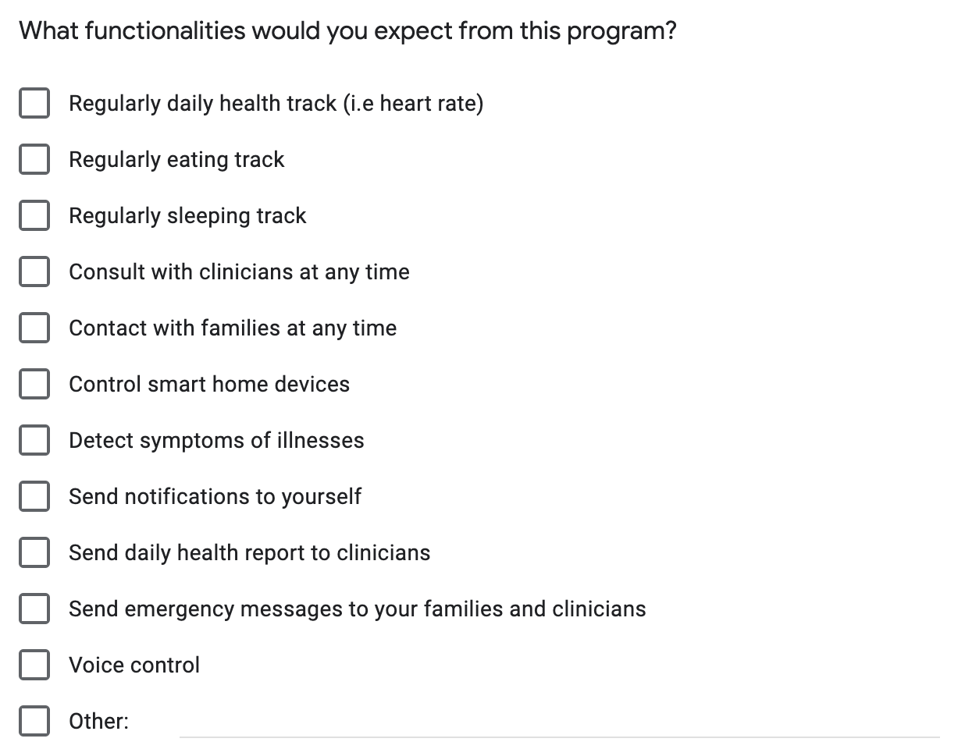
Requirements:

Slide 4
User tests:
Icons are big, so it is easy to tap
Home button is small
Inside contacts, it is hard to separate clinicians and families
It is good to have a notification for having medicine
It’s better to have important notifications shown on home page
Emergency contact is small that may be touched accidently
Doctors are difficult to remember if just shows their names

Slide 5
Future plans:
Continuing develop a better prototype
Change the sizes and fonts of the layouts for better reading
Separate doctors and families in contract
Group doctors in different health departments
Allow elderly to change their emergency contacts
Add more functions based on more user tests (e.g. weather )

